Slide 1
The Inner Critic Presented by Leslie Wright

Slide 3
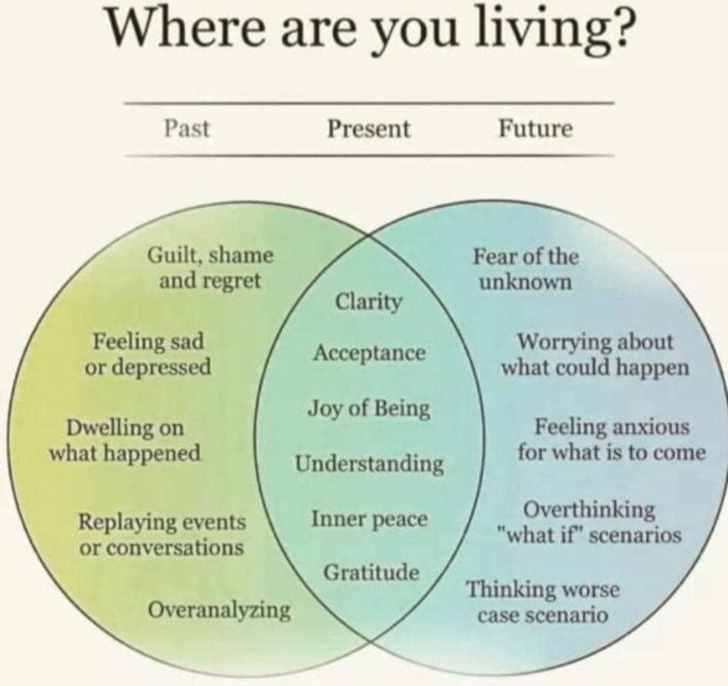

Slide 4
Music Resources
SUN Songs - Song - Ancient Yearnings Artists: Composer: Jodi Proznick Poet - Celeste Snowber Singer - Lailia Baila
Spirit Sings by Debbie Danbrook

Slide 5
Ancient Yearning
We are the language of stars
torsos spinning in light
primal songs
reside in our flesh
Commune with the infinite
underbelly of heart
let what we long for
come to the surface
Trees and tears are our prayers
creation resides in us
ancient beginnings
yearning for home
~ Celeste Snowber

Slide 6
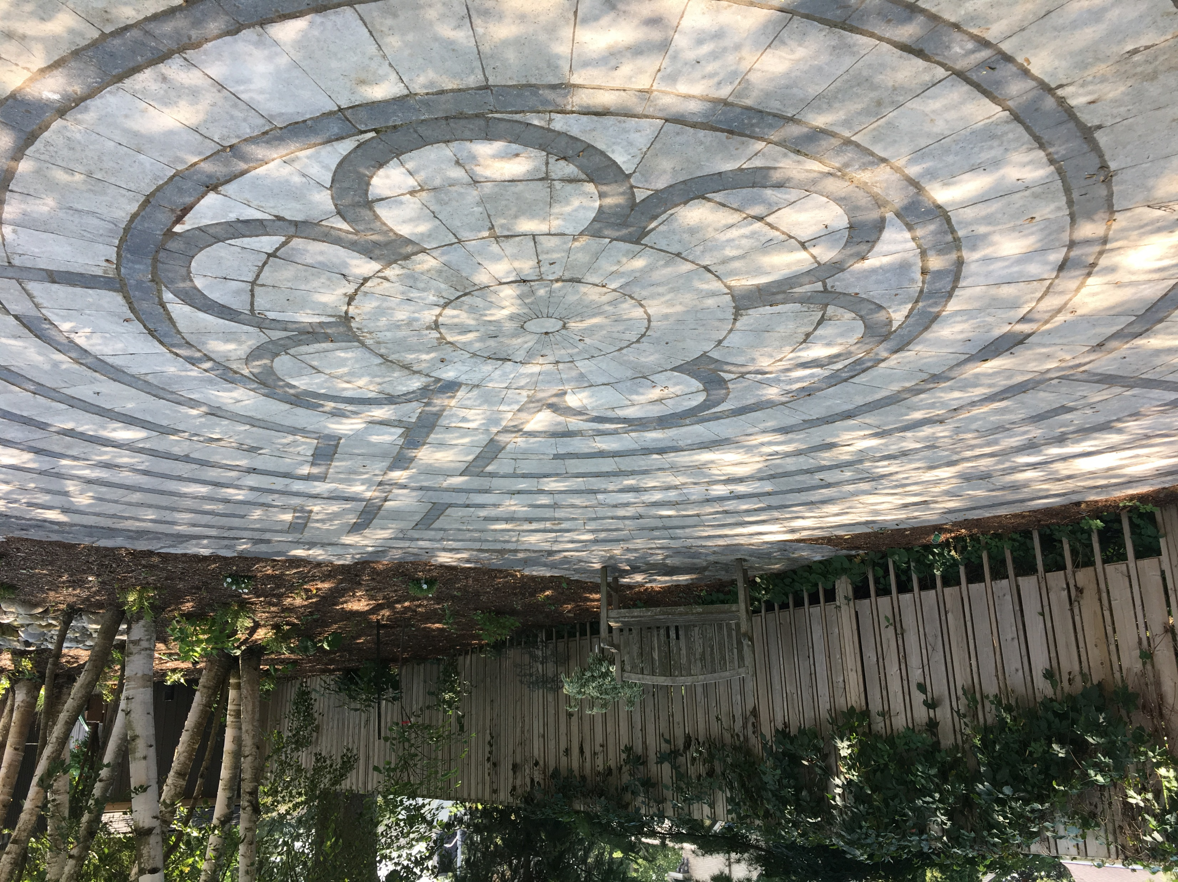

Slide 7
Readings
Dana Faulds – Walk Slowly
John O’Donohue - To Come Home to Yourself

